Slide 1

Personal Liability – Excess Liability
Notes:
3/25/2026 approved by legal || Tina Karkera || 6074351

Slide 2
What is personal excess liability insurance?
____________________________________________________________________________________________________________________________________________________________
Notes:
Let the group find their own words…..
Use a couple of minutes to see how they explain etc.

Slide 3
Who needs excess liability coverage?
Notes:
New Slide
An important part of Excess Coverage is its attachment point, meaning what is the required underlying personal liability that must be maintained to ensure there is no gap in coverage
Underlying insurance is a required amount of primary insurance that must be in place for the excess or umbrella liability policy to respond without a gap.
For example, an underlying requirement might be $100,000 of primary liability. If this underlying amount is not maintained, the excess liability policy will not “drop down”. It will only pay after $100,000.
."

Slide 4

Risky gap between awareness and protections
LIABLIITY EXPOSURES
68%
  express concern about the size of the verdict against them were they to lose a liability case in court.
19%
  of those surveyed carry excess liability insurance.
74%
  of those with excess coverage have limits of $3 million or less.
This coverage gap between the perceived
risk and the level of insurance coverage for liability risk is a potentially devastating one for successful individuals.
Risk audits, mitigation and having
a team of trusted experts behind
a client can significantly strengthen
defences in the event of a lawsuit.
Source: Chubb 2025 Wealth Report
(urvey included 1,000 Successful Individuals.
Notes:
3/25/2026 approved by legal || Tina Karkera || 6074351
3/9/2026 approved by legal || Tina Karkera || 6012485

Slide 5

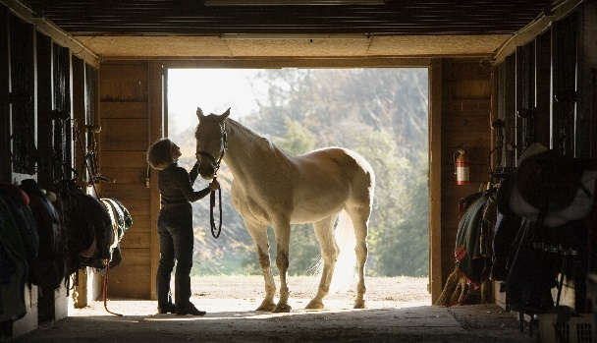
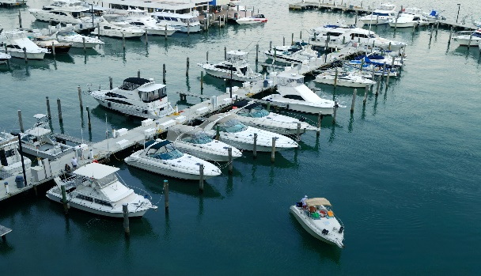


The Chubb Insured – Successful Families & Individuals
Make sure your clients stay protected…..
Everyone (in theory), but especially if you have financial assets to protect and you:
Have teenage/college age children
Entertain large groups of people
Have your children’s birthday parties at outside venues?
Have a swimming pool or boat
Have domestic/private staff
Have a vacation home/rental property
Own a dog, horse, ATV, etc.
Live in a Condo/Coop/Rental where they can cause damage to others resulting from their negligence, fire or water damage
All involve greater risk of liability and damage exposure simply because of increased occurrence likelihood
Notes:
Information for Chubb Marketing Flyer “Masterpiece Excess Liability”
Photos from Chubb Branding site

Slide 6

What does a personal excess policy cover?
Notes:
New Slide
Photo from Chubb branding site
Personal Injury (which includes libel, slander and defamation)
Property Damage
Some of the HNW excess liability policies offer or cover the following
UM/UIM motorist coverage
EPLI
D&O
Etc.

Slide 7
Excess Liability Coverage
…liability coverage in excess of your underlying insurance anywhere in the world unless stated otherwise or an exclusion applies.
Confidential and Proprietary Information of Chubb Personal Risk Services. Do Not Distribute
Notes:
New Slide
IL Contract page W1

Slide 8
Who is this coverage for?
Accidents happen and lawsuits are becoming increasingly common in our society. If a covered loss occurs and your clients are sued for an amount greater than their existing coverage, their assets such as their home, belongings, investments and future earnings could be at risk.
Your clients have worked for years to build financial security for their families. Yet most people don’t realize how easily they can be brought into a lawsuit.
You don’t have to be a millionaire to be sued. Consider these possible examples:
You skid through an icy intersection and hit another car;
A guest at your cookout slips on your deck;
Your child’s friend is hurt while playing in your yard;
Your dog bites your neighbor…again!
Confidential and Proprietary Information of Chubb Personal Risk Services. Do Not Distribute
Notes:
No slide
These are real claims scenarios your clients experience and many involve settlements for damages, medical costs, economic damage, physical and emotional injuries, pain and suffering. We will be sharing 4 specific claims examples towards the end of the end of the presentation.

Slide 9



Potential Liability Exposures and Large Loss Triggers
Multiple claimants
Injury to high income earners (includes UM)
Long term injuries requiring expensive medical care or long-term care plans
Jury awards in difficult plaintiff jurisdictions
New Slide
Chubb Claims Flyer
Notes:
New Slide
Photo from 2025 Wealth Report
Accidents happen and lawsuits are becoming increasingly common in our society. If a covered loss occurs and your clients are sued for an amount greater than their existing coverage, their assets such as their home, belongings, investments and future earnings could be at risk.
We are all hearing more about escalating liability costs ( as recently reviewed in our market Trend presentation) Chubb is not immune to these trends. Our track record of seeing and adjusting large casualty claims means we can bring decades of expertise to these claims.
In our Market trends presentation, we shared information on:
Social inflation¹ is a new term to describe: Increasing litigation, Broader definitions of liability, Growing size of compensatory jury awards
Examples of large judgements²
$8.7 M to a 17-year-old who crashed head first into the boards at a hockey arena while skating on ice that had a hole in it, rendering him a quadriplegic
$24M to two 21-year-old men who were injured in a car accident, one sustaining a catastrophic brain injury.
Growing Cost of Defence²
Panel counsel legal fees have risen at about 3% to 4% per year over the last decade.
Insurance defense firms preferred rates for property and casualty claims currently are on the rise.
Contingency fees, legislative changes and the increasing complexity of litigation also have an impact on defense costs.
Cost of a broken bone higher
Number of experts called is higher

Slide 10
Coverage Features
Personal Injury
libel, slander , defamation of Character, Wrongful Eviction & Mental injury – even if occurring through social media *
Worldwide Coverage
Limited Directors Liability
nonprofit organization, covering aspects of D&O
Full Protection
worldwide homes, automobiles, watercrafts can be covered on the policy
Unlimited Defense Costs
coverage outside of your limits which continues even if the liability limit is exhausted by payments
No Deductible
Optional Uninsured Motorists
Broad Definition of Named Insured
Worldwide Rental Car Coverage
Up to 60 days
Follow form to our Personal Liability Coverage
High Limits
up to $100m
* High profile clients may be limited for this coverage feature
Coverage may vary by state. For illustration purposes only. Coverage is subject to the language of the policies as actually issued
Notes:
3/25/2026 approved by legal || Tina Karkera || 6074351

Slide 11


The Chubb Insured – Successful Families & Individuals
Excess Liability – Underlying Insurance
Underlying Insurance
We will pay only for covered damages in excess of all underlying insurance covering those damages, even if the underlying coverage is for more than the minimum amount.
Required primary underlying insurance. Only liable in excess of minimum, amounts of bodily injury and property damage:
Homeowners || 100K minimum amount.
Registered/Unregistered vehicles || $300K minimum amount.
Watercraft less than 26 feet and 50 HP || $100K minimum amount.
Watercraft 20 feet and 50 HP or more || $500k minimum amount.
Uninsured and underinsured motorist protection || $500K minimum amount
Notes:
3/25/2026 approved by legal || Tina Karkera || 6074351
Photos from Chubb branding site
An important part of Excess Coverage is its attachment point, meaning what is the required underlying personal liability that must be maintained to ensure there is no gap in coverage
Underlying insurance is a required amount of primary insurance that must be in place for the excess or umbrella liability policy to respond without a gap.
For example, an underlying requirement might be $100,000 of primary liability. If this underlying amount is not maintained, the excess liability policy will not “drop down”. It will only pay after $100,000.
."

Slide 12
Special Limits
Money | $300 (including coins and medals) | $300 (including coins and medals) | $1,500 (coins and medals included in Collectible category below)
Securities, deeds, etc. | $2,000 (including stamps) | $2,000 (including stamps) | $5,000 (stamps included in Collectible category below)
Trailers | $2,000 | $2,000 | $5,000
Watercraft | $2,000 | $2,000 | $10,000
Jewelry | $2,000 stolen | $2,000 lost, misplaced or stolen | $5,000 lost, misplaced or stolen
Furs | Included in jewelry limit | Included in jewelry limit | $5,000 lost, misplaced or stolen
Silverware | $3,000 stolen | $3,000 lost, misplaced or stolen | $10,000 lost, misplaced or stolen
Collectible Stamps, Coins, and Medals | Included in above limits | Included in above limits | $5,000
Guns | $3,000 stolen | $3,000 lost, misplaced, or stolen | $5,000 lost, misplaced or stolen
Liability Coverages
Personal Injury (libel and slander) | Not Included² | Not Included² | Included
Medical Payments | Reasonable Expense | Reasonable Expense | $50,000
Credit/Bank Card | Not Included² | Not Included² | $10,000 (includes theft of credit card number on internet)
Identity Fraud Expenses | Not Included² | Not Included² | $50,000 per occurrence
Incidental Business at Home | Not Included⁹ | Not Included⁹ | Included
Incidental Farming | Not Included | Not Included | Included
Kidnap Expense | No Coverage | No Coverage | $100,000
$1,500 on electronic apparatus off premises (HO-3 and HO-5); Chubb Masterpiece $2,500 on electronic data apparatus off premises used to conduct business.
Enrollment in our Wildfire Defense Services is available to Chubb homeowners policyholders in the states of AZ, CA, CO, FL, GA, ID, MT, ND, NM, NV, OK, OR, SC, SD, TN, TX, UT, WA, and WY.
Coverage provided for certain activities for which no insured receives more than $15,000 in total compensation for the 12 months before the beginning of the policy period.

Slide 13
The following charts compare other coverages from Chubb to similar coverages, if any, in the marketplace.
Industry Endorsement (ISO)
Chubb Masterpiece
Employment Practices Liability Coverage (EPLC)¹⁰
Chubb’s Employment Practices Liability coverage helps provide additional protection for clients who employ residential staff in their homes - like nannies, housekeepers, or gardeners. Chubb helps cover costs associated with accusations of wrongful termination, sexual harassment, and employment discrimination.
EPLC – Option A | Coverage Not Available | Employment Practices Liability¹¹ $250,000 per occurrence; $500,000 annual aggregate Reputational Injury $25,000 (no deductible applies)
EPLC – Option B | Coverage Not Available | Employment Practices Liability¹¹ $500,000 per occurrence; $500,000 annual aggregate Reputational Injury $ 50,000 (no deductible applies)
Family ProtectionSM Coverage
Whether at home, on the road, or online, we understand the emotional and financial burden that can come from experiencing a serious crime. With Chubb’s Family Protection, we help make sure if clients - or someone they love - fall victim to a serious crime like cyberbullying, stalking, or carjacking, they have the support and protection they need.
Home Invasion | Coverage Not Available | Up to $270,000 for covered expenses
Child Abduction | Coverage Not Available | Up to $300,000 for covered expenses resulting from abduction of a child under the age of 13
Carjacking¹² | Coverage Not Available | Up to $255,000 for related expenses
Stalking Threat | Coverage Not Available | Up to $60,000 for covered security measures
Cyberbullying | Coverage Not Available | Up to $60,000 for covered expenses
Available to Personal and Excess Liability policy.
$10,000 deductible applies per occurrence
Carjacking is not available in Florida.

Slide 14
Industry Endorsement (ISO)
Chubb Masterpiece
Valuable Articles
(ISO H004 61 0322)
While typical homeowner’s policies are designed to protect your home and what’s inside, there is usually limited coverage for valuable possessions - such as jewelry, fine art, wine and spirits, antiques, and collectibles - that may get lost, stolen, or damaged. A Chubb Valuable Article policy provides insurance for clients’ collections to provide confidence that special possessions are protected.
Fine Arts Breakage | Limited² | Included
Fine Arts Expense | Coverage Not Available | Up to $50,000 for legal costs incurred due to lack of or defective title
Blanket Coverage | Limited¹³ | Available for all classes¹⁴
Newly Acquired Fine Arts | 25% of the itemized amount | 25% of total itemized amount for Fine Arts
Newly Acquired Items – Jewelry, Furs, Cameras, Musical Instruments, and Collectibles | The lesser of 25% of the itemized amount or $10,000 | 25% of total itemized amount for the category
Loss Payment of Itemized Articles | Itemized Amount | Up to 150% of itemized amount¹⁵
Cyber Protection Coverage¹⁶
With all the ways technology has enhanced our lives, comprehensive cyber protection helps clients avoid the lasting impact of emerging concerns – like identity theft, hacking, cybercrime, and cyberstalking or harassment.
Cyber Extortion | Coverage Not Available | Up to $50,000
Cyber Financial Loss | Coverage Not Available | Up to $500,000
Cyber Personal Protection, which includes Cyberbullying, Cyber Disruption, Cyber Breach of Privacy, and Data Recovery | Coverage Not Available | Up to $500,000
Notes: ______________________________________________________ ____________________________________________________________________________________________________________________________________________________________________________________________________________________________________________________________________________________
Up to $1,000 on any unscheduled coin collection, $250 for any one stamp, coin, or individual article.
Jewelry, furs, fine arts, stamps – $50,000 per-item limit; silverware, cameras, musical instruments – no per-item limit.
If the market value of the itemized article immediately before the loss exceeds the itemized amount, loss payment is market value up to 150% of the itemized amount, but not more than the maximum amount of coverage. This coverage is available in most jurisdictions.
Maximum aggregate limits for all covered cyber occurrences, up to $500,000 per policy period, depending on the limits chosen.
The comparison contained herein was prepared solely by Chubb based upon a good faith, objective reading of the language of the basic policy forms and/or endorsements and highlights selected coverages of the policies referenced as of 4/2/2022 and is subject to change without notice. The comparison is based on the coverage forms noted.
Chubb is the marketing name used to refer to subsidiaries of Chubb Limited providing insurance and related services. For a list of these subsidiaries, please visit our website at www.chubb.com. Insurance provided by ACE American Insurance Company and its U.S. based Chubb underwriting company affiliates. All products may not be available in all states. This communication contains product summaries only. Coverage is subject to the language of the policies as actually issued. Surplus lines insurance sold only through licensed surplus lines producers. Chubb, 202 Hall’s Mill Road, Whitehouse Station, NJ 08889-160. Form 02-01-0093 (Ed. 5/22)

Slide 15
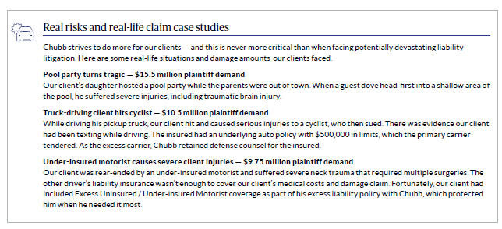
Notes:
New Slide
Chubb liability Flyer

Slide 16
How Much Should You Purchase?
Assets
$
Future Income
$
Coverage needed
+
=
Match the combination of your net worth and future income stream.
Confidential and Proprietary Information of Chubb Personal Risk Services. Do Not Distribute
Notes:
New Slide
Chubb Claims Flyer
Remember that we are not just talking Chubb Insureds
Approx 40% of successful household have less than $5 million in umbrella liability coverage.
Approx 21% who have NO umbrella/excess at all.
Without the additional protection, families can be forced to sacrifice their homes, their savings and investments, and their future income stream to pay damages.

Slide 17

Approximately what does excess liability cost per million?
Notes:
New Slide
Photo from Chubb branding site
Rates vary by state and are filed in each state.
Plain vanilla account – 2 homes, 2 cars and a 34ft watercraft. Generally not more then approx. $500 per million – once over $10M increases slightly due to reinsurance but again around $600 per million. Of course, this can be impacted by various factors.
Less then it cost the insured a $1M home.

Slide 18
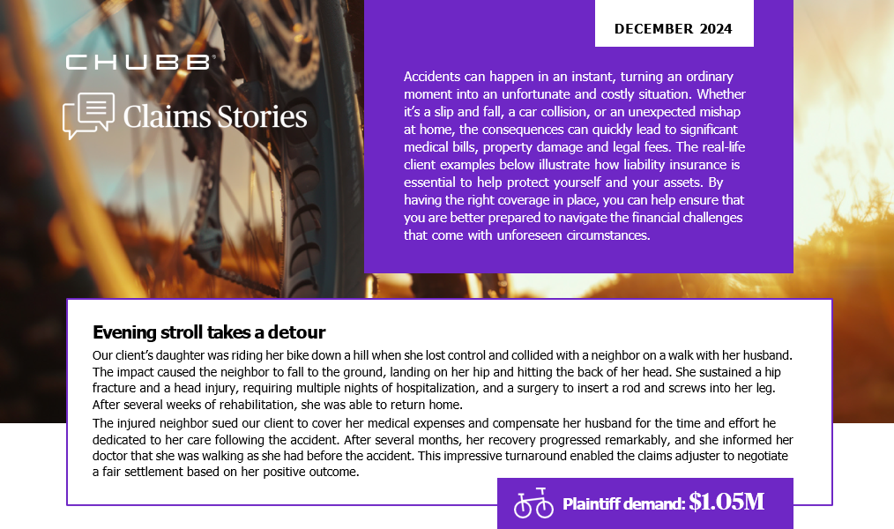
Notes:
New Slide
Chubb Claims Flyer

Slide 19
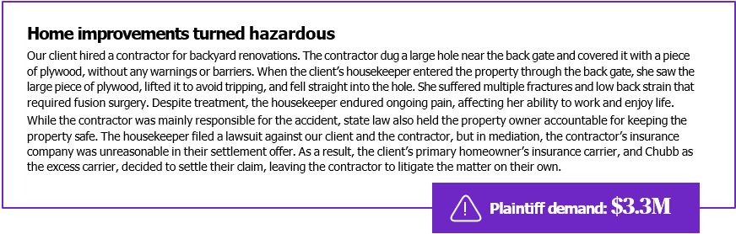
Notes:
New Slide
Chubb Claims Flyer

Slide 20
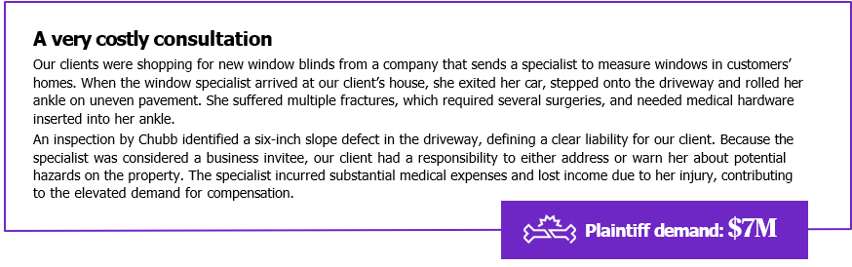
Notes:
New Slide
Chubb Claims Flyer

Slide 21

Questions?
Jonathan Fajen
SVP, Custom Solutions Leader, Personal Risk Services
11575 Great Oaks Way, Alpharetta, GA 30022, USA
M 470-557-2322
E Jonathan.Fajen@Chubb.com
HUB-Chubb
The claim scenarios described here are intended to show the types of situations that may result in claims. These scenarios should not be compared to any other claim. Whether or to what extent a particular loss is covered depends on the facts and circumstances of the loss, the terms and conditions of the policy as issued and applicable law. Facts may have been changed to protect privacy of the parties involved.
21
Notes:
Added this disclosure per legal’s request -3/9/2026 approved by legal || Tina Karkera || 6012485

