Slide 1
Development Program
The Chubb Auto Difference
Insurance that exceeds your everyday expectations
June 4, 2026

Slide 2
Agenda
Claim Frequency & Severity
Advertising Spends
3. Vehicle Complexity
4. Total Thefts
5. UM/UIM
6. Collector Vehicles
7. Electric Vehicles (EVs)
2

Slide 3
1. Claim Frequency & Severity
3

Slide 4
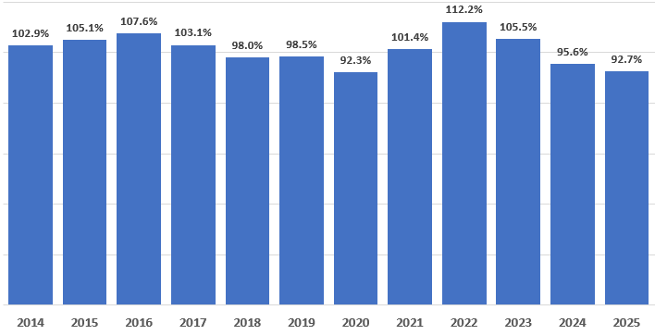
1. Claim Frequency & Severity
US Private Passenger Auto Combined Ratios
Source: S&P

Slide 5
1. Claim Frequency & Severity
US Private Passenger Auto Filed Rate Change (Industry)
Auto insurers aggressively increased rates in 2022 -2024 to address economic & social inflation
2025 rate activity was minimal and 2026 is also starting out with very small rate increases with some insurers filing rate decreases.
Source: PRS Competitive Analytics using date from S&P

Slide 6
1. Claim Frequency & Severity
Physical Damage claim frequencies were down in the most recent 4 quarters, while severity was up for Collision and down for Comprehensive.
Collision severity continues to increase due to vehicle complexity. Tariffs impacts have been minimal.
Collision frequency has been declining due shifting away from rush hour travel, greater propensity to self insure for smaller claims and ADAS accident prevention features.
Comprehensive severity was down due to a decline in convective storms/hail claims, declining vehicle thefts and an Atlantic hurricane season that avoided the Gulf Coast & Eastern Seaboard.

Slide 7
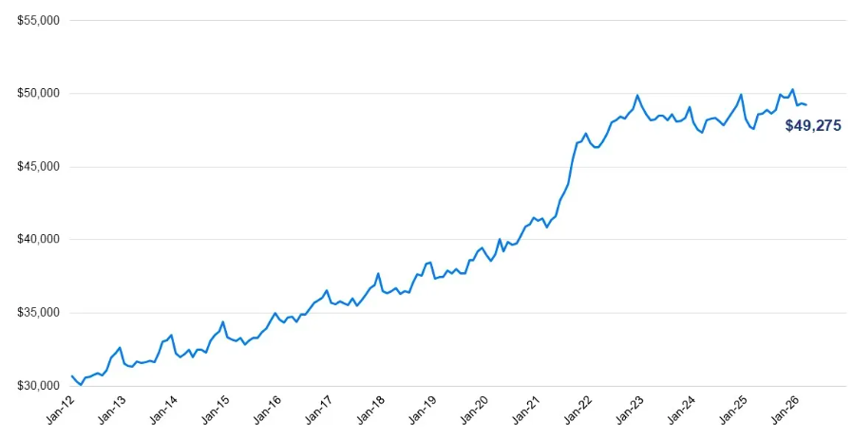
1. Claim Frequency & Severity
New and used vehicle pricing had moderated which
Average New Vehicle Transaction Price
The average new vehicle transaction price increased 31% in 2023 vs 2019 ($37,556 -> $49,075).
The average used car price increased 39% during the same time period ($19,548 -> $27143)
Supply chain issues resulted in manufacturers producing fewer new cars, which also put upward pressure on used car prices.
Partial loss severities also increased because higher priced cars makes it economical to repair relatively heavily damaged vehicles that previously would have been totaled.
Increased new car production has helped stabilize new and used car pricing which has in turn reduced upward pressure on Physical Damage claim severities.
Source: Cox Automotive

Slide 8
1. Claim Frequency & Severity
While Bodily Injury frequency was down in the most recent 4 quarters, severity continues to increase.
BI severity is being driven by social inflation, litigation, and changing jury behavior—not by more severe crashes.

Slide 9
2. Advertising
Spends
9

Slide 10
Our Challenge
P&C Insurance advertising increased to the highest level ever in 2025, with the vast majority of advertising focused upon saving money by switching to a lower priced Auto insurer.
Industry PPA Combined Ratios | 101% | 112% | 106% | 96% | 93%
Industry PPA Filed Rate | 3% | 12% | 17% | 7.5% | 0.3%
Source: 04/27/26 Auto Insurance Report /Dowling & Partners

Slide 11
P&C Insurance Ad Spends by Company
While many Auto insurers significantly increased their advertising spends in 2024 & ‘25, Progressive, Geico and Allstate stand out
Source: 04/27/26 Auto Insurance Report /Dowling & Partners

Slide 12
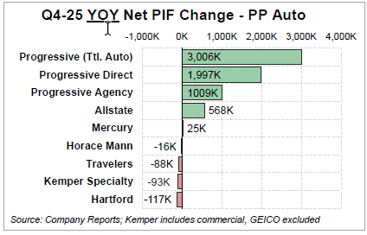
P&C Insurance Ad Spends by Company
Big Advertising spends by the top writers are paying off in terms of policy & premium growth
Geico Policy Count
  2023: -14.4%
  2024: -0.5%
  2025: +5.3
2025 Ad Spend: $91M, +15%

Slide 13
3. Vehicle Complexity
13

Slide 14
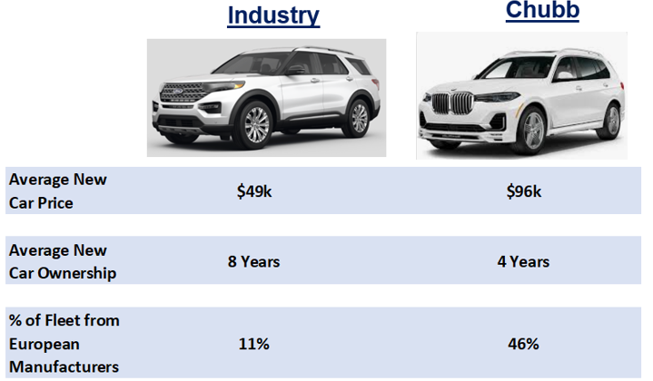
Average New Car Prices
Chubb clients buy new vehicles that are about twice as expensive as the average new vehicle. They also turn them over more frequently and have a preference for European makes.

Slide 15
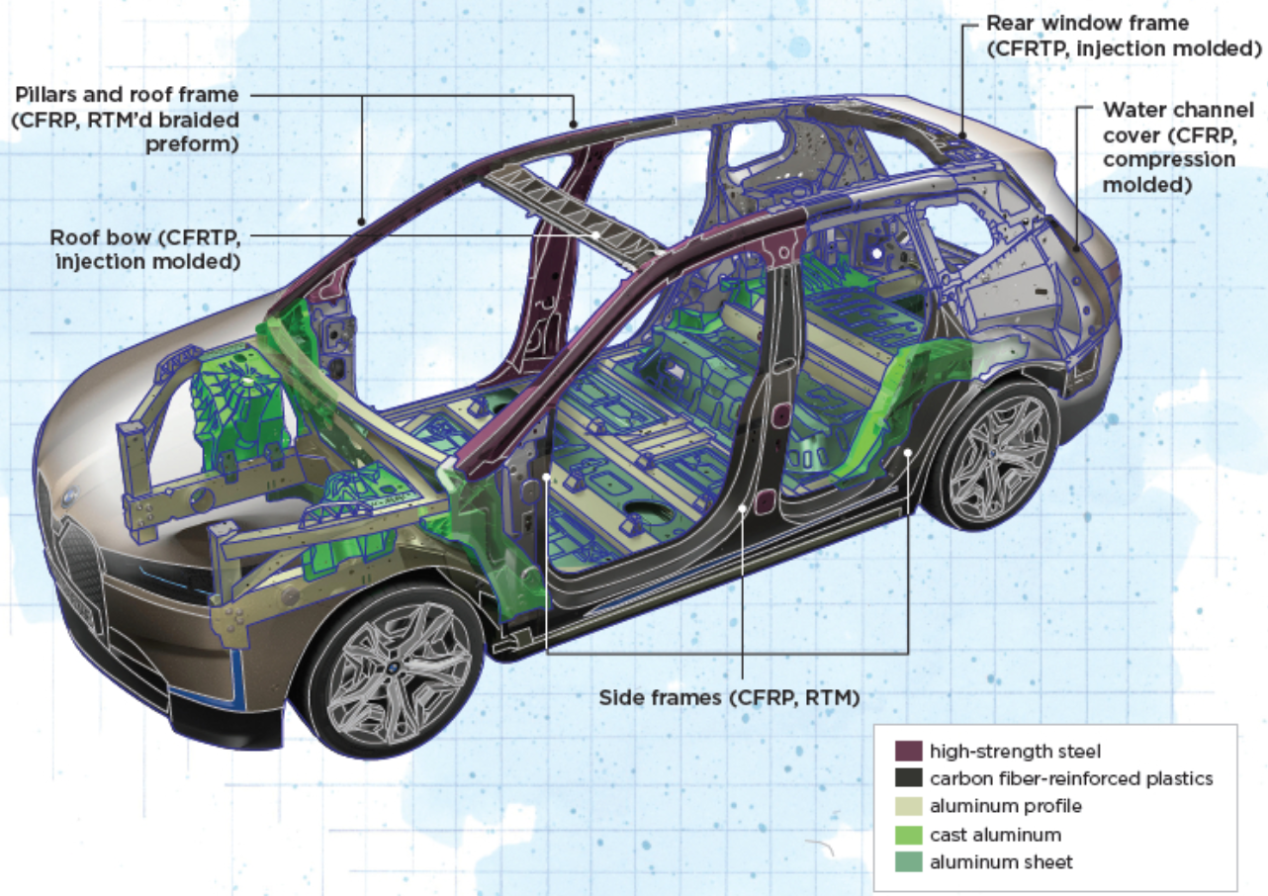
Vehicle Construction is Becoming Increasingly Complex
Lightweight vehicle construction has many benefits, but Multi-material construction greatly increases collision repair complexity, driving up claim severities
Lightweight vehicle construction improves fuel economy, reduces emissions and enhances performance.
It also contributes to better crashworthiness and allows for more advanced safety and electronic systems to be integrated without increasing overall vehicle weight.
Today’s complex high-end vehicles should be repaired at certified shops to ensure the repairs are done properly

Slide 16
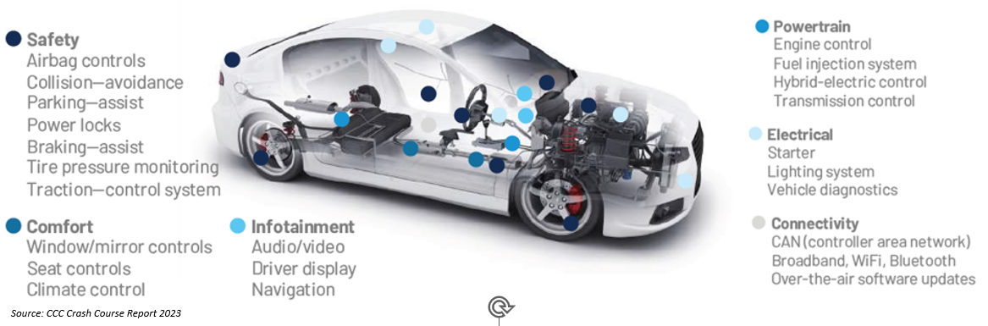
Today’s Vehicles are Extremely Complex
Today’s increasingly complex vehicles require repairs to be made by highly skilled (and highly paid) technicians
The average car is packed with 1,400 semiconductors that control everything from airbags to the engine. Modern cars simply cannot run without chips.
Electric Vehicles have twice as many chips as Internal Combustion Engine (ICE) vehicles.

Slide 17
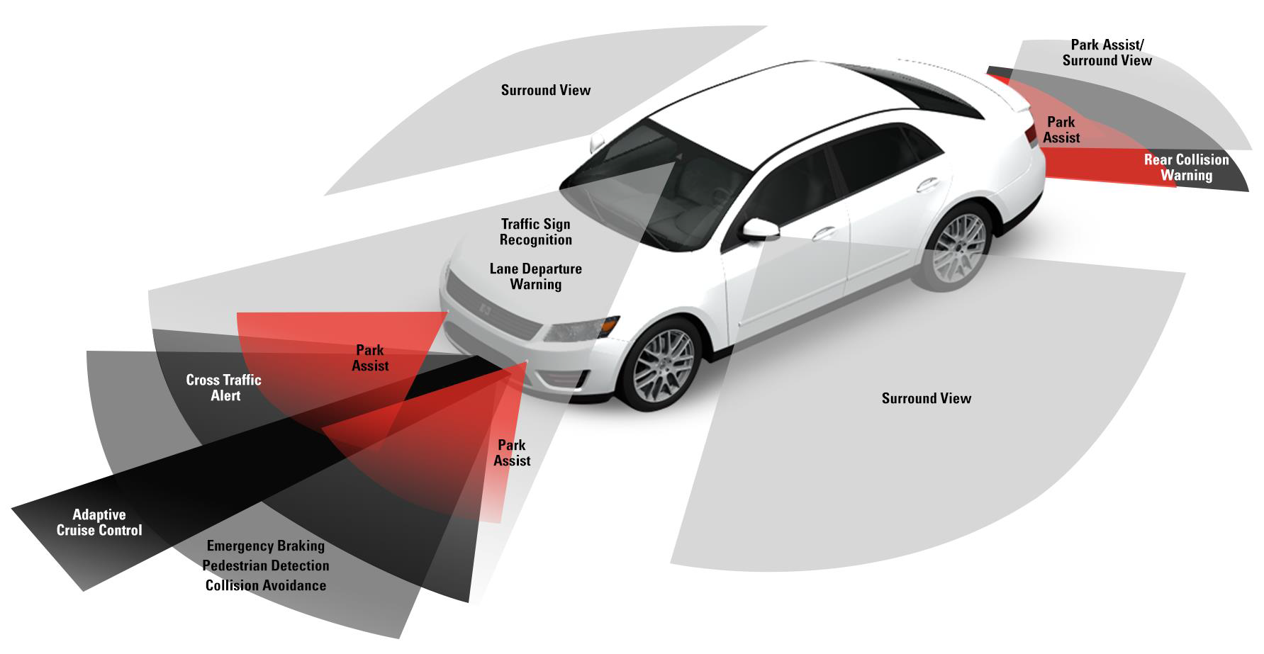
Advanced Driver Assistance Systems (ADAS)
ADAS technologies are designed to make vehicles safer by automating, improving or adapting some or all the operational tasks
.

Slide 18
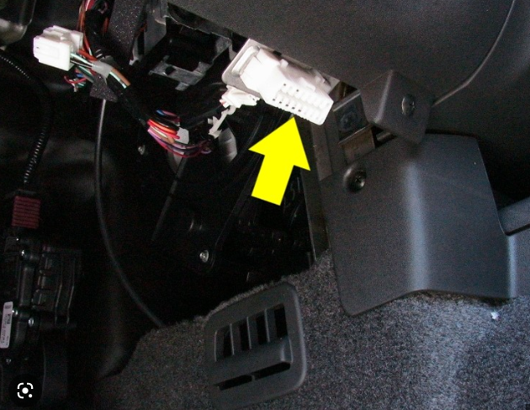
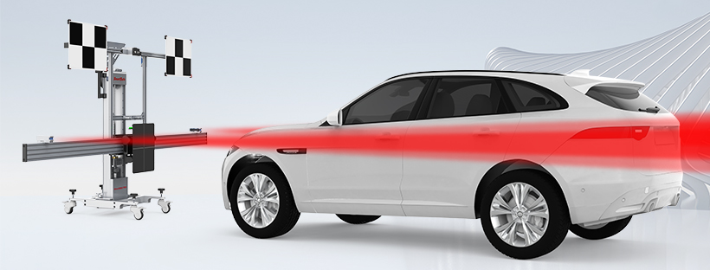
ADAS Repairs Contribute to Increasing Claim Severities
Scans & Recalibrations are becoming commonplace as vehicle complexity increases
Scan
Recalibration

Slide 19
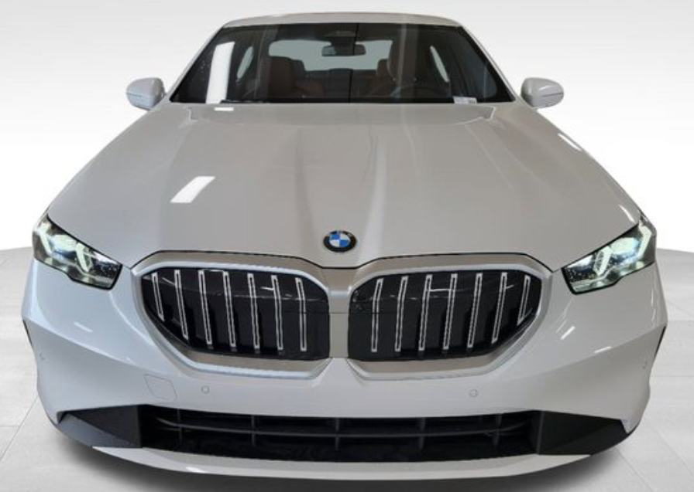
ADAS (& Headlight) Repairs Contribute to Increasing Claim Severities
While ADAS features contribute to lower accident frequencies, their high cost of repair increases claims severity putting upward pressure on rates.
Parts + Labor costs for a Front-End Collision
2024 BMW 5 Series 540i xDrive 4D

Slide 20
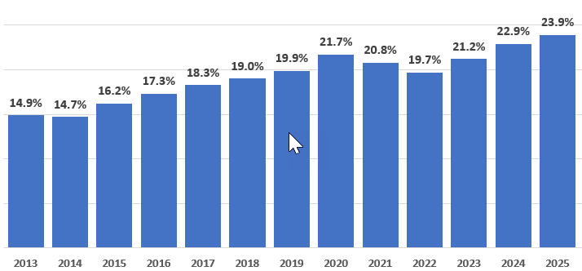
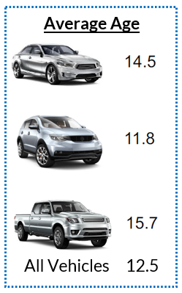
Total Losses Are Increasing
Vehicle complexity and an aging US fleet are contributing to increased total losses
Source: CCC Crash Course 26
The increase in total losses is back on its pre-pandemic trajectory
Source CCC, 1Q25 Crash Course
Source S&P Mobility

Slide 21
OEM Certified Technicians are Well Compensated
Body Shop Technician compensation increases substantially as experience and training increase
    In 2025, the average labor rate paid by the auto insurance industry was $67.46 per CCC

Slide 22
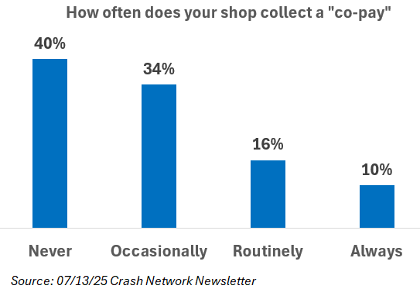
“Short-Pays” & “Co-Pays”
Mass market Auto insurer “Short-Pays” & “Co-Pays” are becoming increasingly common
    Mass market auto insurers often cap hourly labor rates, will only pay for aftermarket or junkyard parts and won’t pay of OEM repair procedures.
    Insurer “short-pays” result in many shops routinely charging “co-pays” beyond the client’s deductible.
    Only 40% of shops never charge a “co-pay”, while 26% of shops routinely or always do.
    The average co-pay amount is $700.

Slide 23
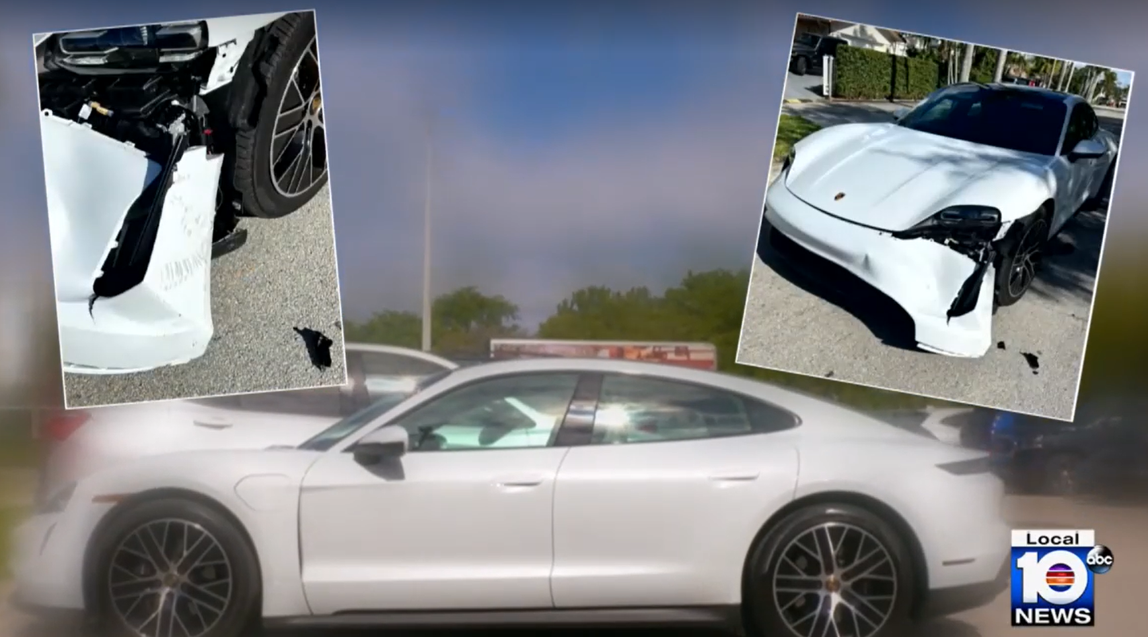
“Short-Pays” & “Co-Pays”
Real world “co-pay” example for a mass market auto customer
    A Porsche certified repair shop quoted $8,361 to fix the damage to this $100k 2022 Porsche Taycan EV.
    Porsche advised that if the repair wasn’t done at a Porsche certified shop the vehicle’s warranty would be voided.
    Using a labor rate of $47/hour, State Farm was only willing to pay $6,267.
    The Taycan owner paid a $2,094 “co-pay” out of pocket and initiated a class action lawsuit against State Farm.
    Source: https://www.local10.com/news/local/2024/02/27/south-florida-driver-part-of-class-action-claiming-state-farm-wasnt-there-for-them-failing-to-foot-repair-bills/

Slide 24

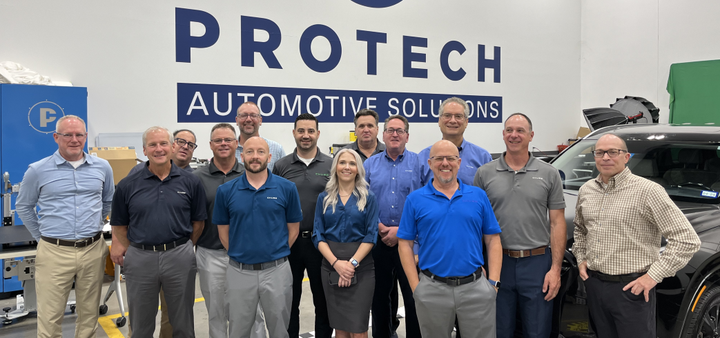
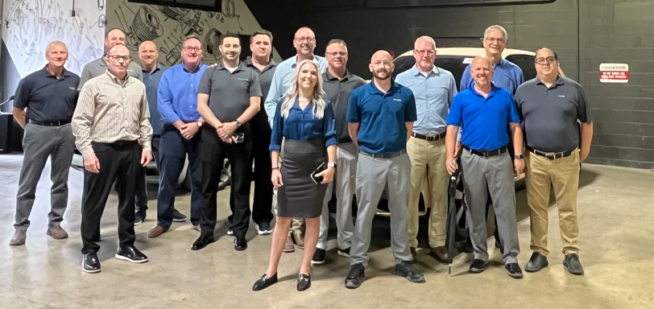
Chubb Auto “Collision Repair Experts”
Chubb CRE’s Manage complex claims regardless of vehicle value or client size and deal directly with shops, relieving clients of the need to engage in stressful discussions on topics most are unfamiliar with
    13 Auto Collision Repair Experts(CREs) + 1 Supervisor
    Certified collision repair experts.
    Primary focus is High Quality and Safe repairs.
    Insist upon manufacturer approved repair techniques.
    Maintain relationships with manufacturer reps to obtain guidance on complex repairs and get difficult to obtain parts.

Slide 25

Chubb Direct Repair Program – Safety over Cost Cutting
Chubb network shops are selected based upon performing high quality repairs, not because they’ll perform repairs at rock bottom prices.
606 shops selected because they perform high quality repairs which are up to our high standards, not because they are cheap.
Most are certified by high end manufacturers to repair the complex vehicles our clients own.
We specify OEM parts and insist that cars be repaired in accordance with manufacturer approved repair techniques or not at all.
We seek no discounts from MAPS shops as this can result in corner cutting that reduces repair quality and safety.

Slide 26
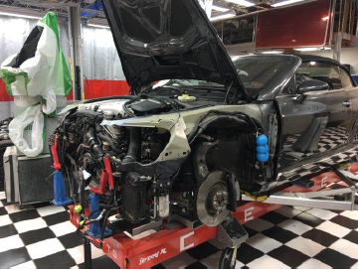
Certified Collision Repair Shops
Certified repair shops are trained by vehicle manufacturers on the proper way to repair vehicles to ensure all safety systems operate as designed in the event of a subsequent crash
    Certified repair shops invest heavily in technician training and tooling.
    The initial investment to become a certified shop can be in excess of $250k.
    Technicians receive ongoing training to learn certified repair techniques.
    Shops must purchase and use tools such as welders, rivet guns, adhesive guns, etc. specific to each manufacturer’s model and programs.
    Frame straightening machines like this one cost $80k or more.

Slide 27

Parts Restrictions
High-end manufacturers like Audi, BMW, Mercedes, Porsche, Tesla, Volvo all have parts restrictions on structural high strength steel, aluminum and carbon fiber parts because they require factory training and specialized equipment to properly install
    Damage to restricted parts can’t be repaired & parts must be replaced.
    OEMs will only sell restricted parts to certified shops and only certified shops have the training and tooling to properly install them.
    Since non-certified shops have no access to restricted parts, it’s only possible for them to “repair” restricted parts which greatly compromises the vehicle’s safety.

Slide 28
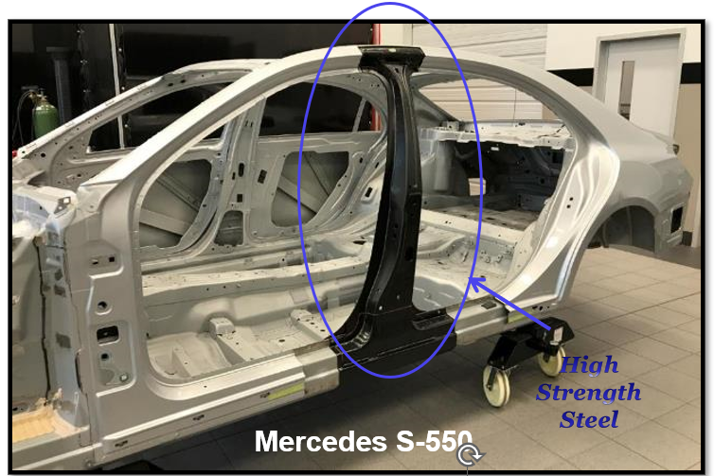
High Strength Steel (HSS)
High Strength Steel must always be replaced, never repaired.
Heating or bending HSS back into shape will compromise its structural integrity putting vehicle occupants at risk.
Shops that are untrained or unscrupulous may repair HSS.
Our CREs help make sure this doesn’t happen to our clients’ vehicles.

Slide 29
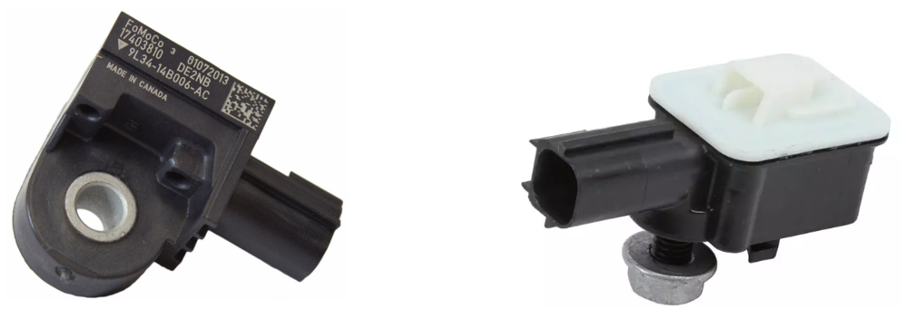
Small Mistakes Can Have Serious Consequences
Side Airbags are crucial to protecting vehicle occupants in the event of “T-Bone” accident
    Sensors inside the vehicle’s doors detect air pressure changes in order to deploy the side airbags.
    Improper door repairs can change the volume of air in the door, adversely impacting the timing of airbag deployment, compromising occupant safety.

Slide 30
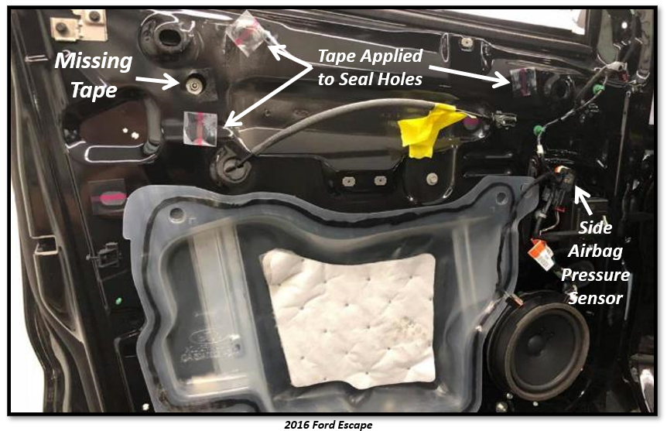
Small Mistakes Can Have Serious Consequences
Something as seemingly minor as not taping holes (as was done when the vehicle was manufactured) will throw off air pressure within the door and the timing of side airbag deployment.
    A Chubb Collision Repair Expert took this photo at a repair shop. He pointed out the missing tape to the shop technicians.
    None of the shop’s technicians knew the airbag sensor utilized air pressure within the door.

Slide 31
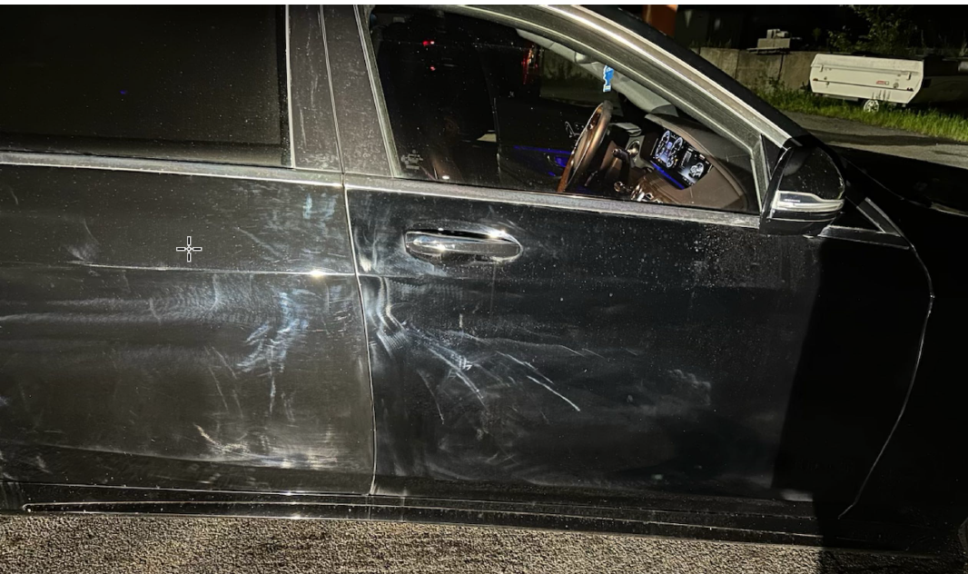
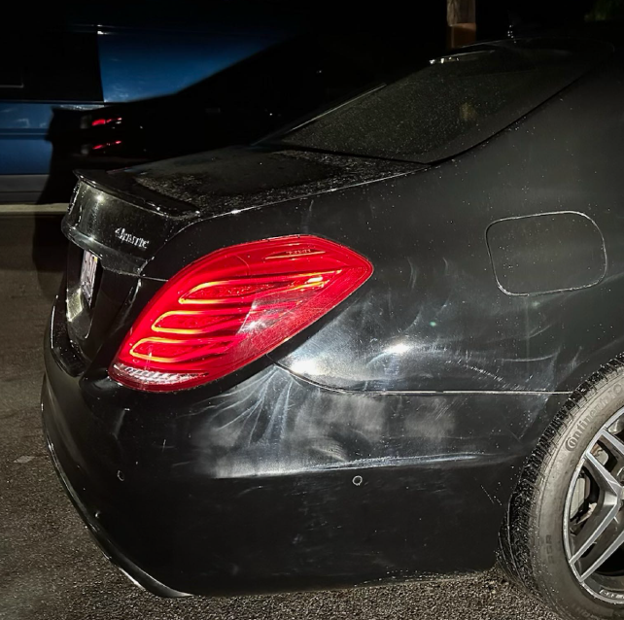
Improperly Repaired Mercedes S550

Slide 32
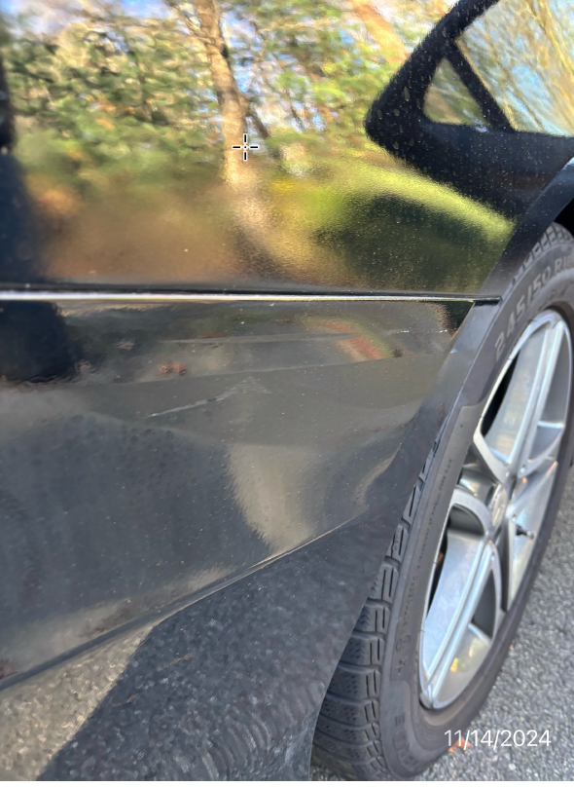
Improperly Repaired Mercedes S550

Slide 33
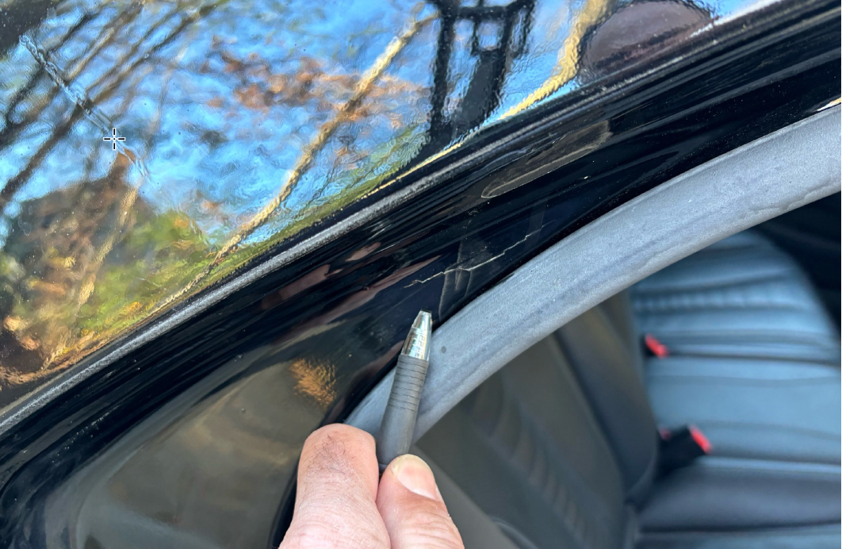
Improperly Repaired Mercedes S550

Slide 34
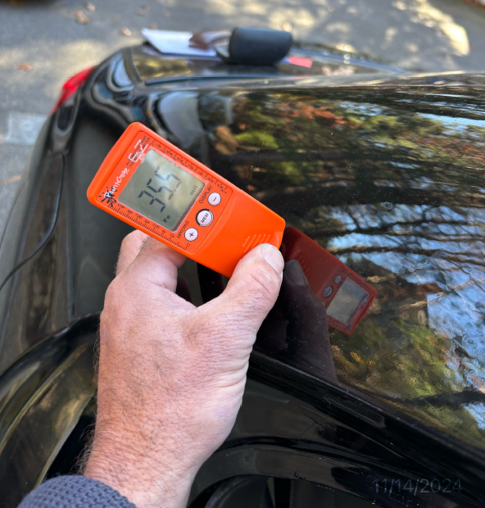
Improperly Repaired Mercedes S550
    Paint depth meter reading: 35.5 mils
    Normal paint depth reading: 3.5 – 5.5 mils
    1 mil = 1/1000 inch

Slide 35
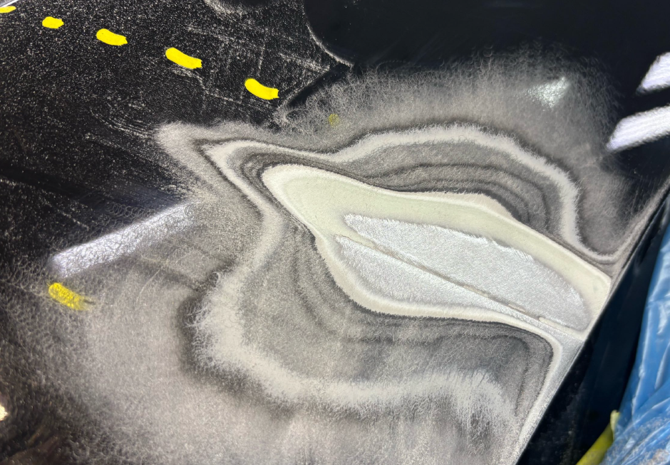
Improperly Repaired Mercedes S550
    RM

Slide 36
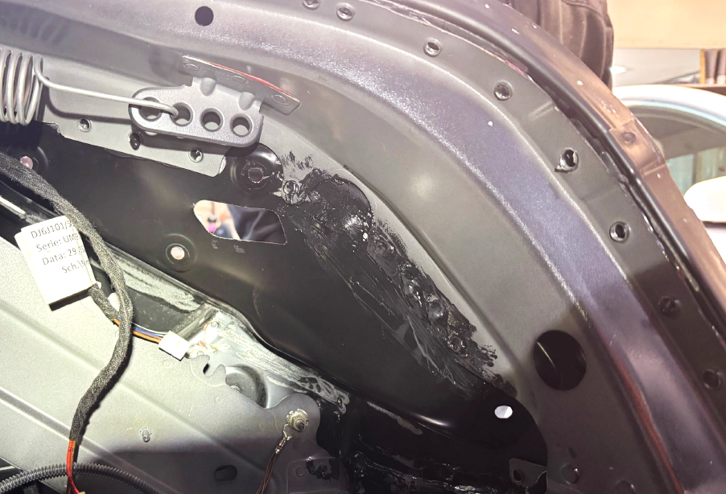
Improperly Repaired Mercedes S550
    RM

Slide 37
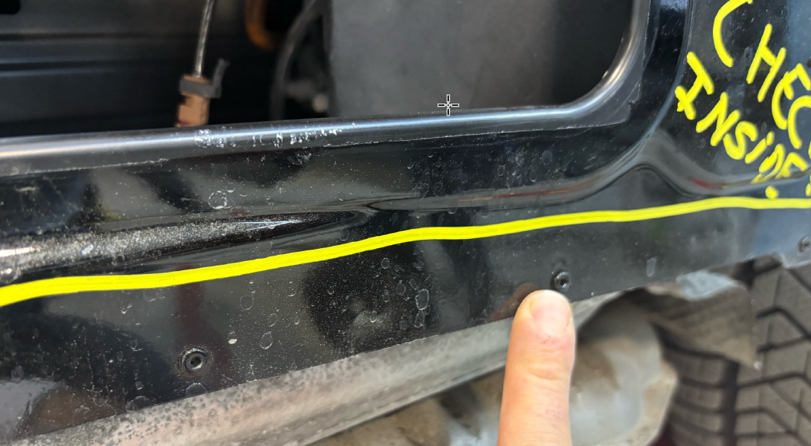
Improperly Repaired Mercedes S550
    RM

Slide 38
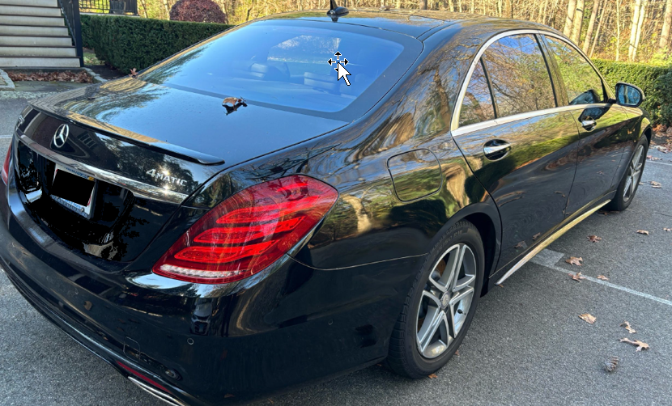
Improperly Repaired Mercedes S550
    RM

Slide 39
Improperly Repaired Mercedes S550
Excerpt from Client Letter:
All I can say is this. Any successful business is about the people. I have been CEO of an S&P 500 company and today I am CEO and/or Chairman to 5 different biotech companies. I know what good looks like. I have hired, managed and led thousands of people in my career. Robert and Melissa are outstanding.
The incident locks me in as a happy Chubb customer. In my circles of friends between Boston, Nantucket and Deer Valley Utah, where I own homes and cars…I will be telling my friends and colleagues about how Chubb does business…not to simply make money (though all businesses need to make money), but to insure and protect their customers to “do the right thing.” Doing the right thing is in fact the best way to build a successful business and make money.
If I were starting a new business today, I would be looking for people like Robert and Melissa.
    RM

Slide 40
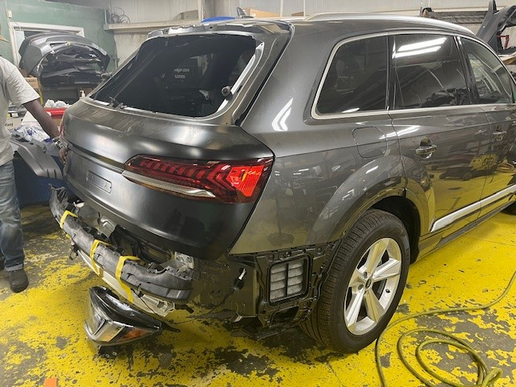
2024 Audi Q7, Aluminium Construction
The client took the vehicle to a shop that wasn’t certified by Audi
    RM

Slide 41
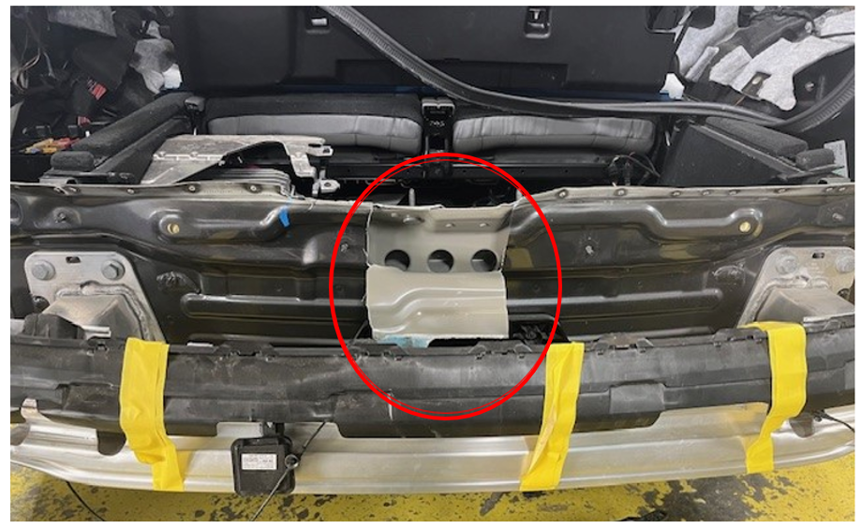
2024 Audi Q7, Aluminium Construction
Not knowing that Audi doesn’t permit unibody structural pulls, the shop damaged the rear body panel and inner reinforcement. Audi would not sell replacement parts to this non-certified shop because they’re restricted.
    RM

Slide 42
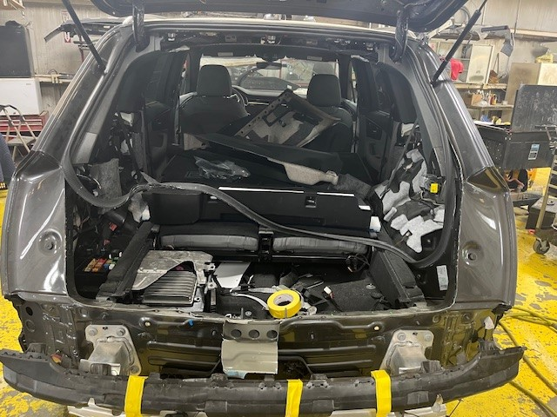
2024 Audi Q7, Aluminium Construction
Chubb Collision Repair Expert (CRE) stepped in and persuaded an Audi certified shop to assume the repair
    RM

Slide 43
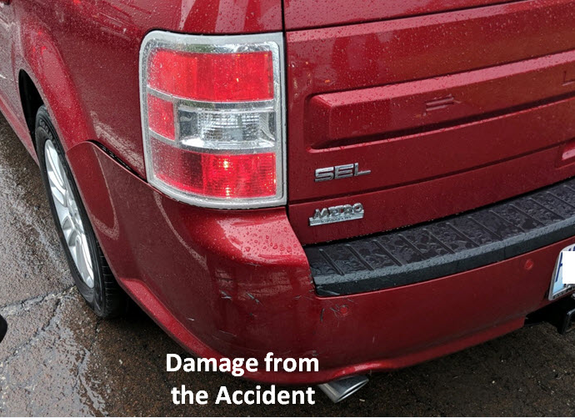
Aftermarket, Junkyard & “Re-manufactured” Parts
Mass market carriers commonly use aftermarket, junkyard and remanufactured parts, while Chubb specifies OEM parts and procedures.

Slide 44
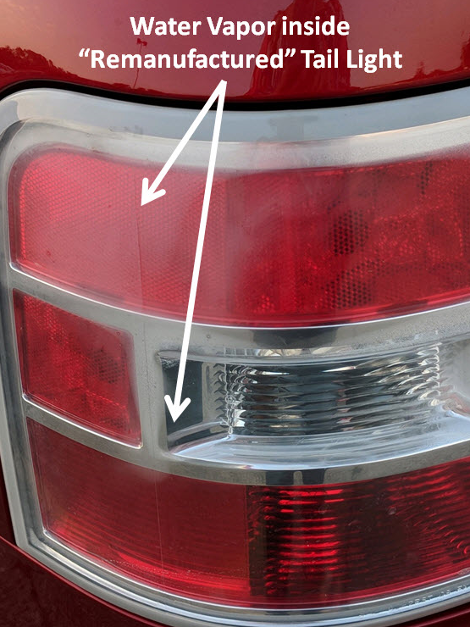
Aftermarket, Junkyard & “Re-manufactured” Parts

Slide 45
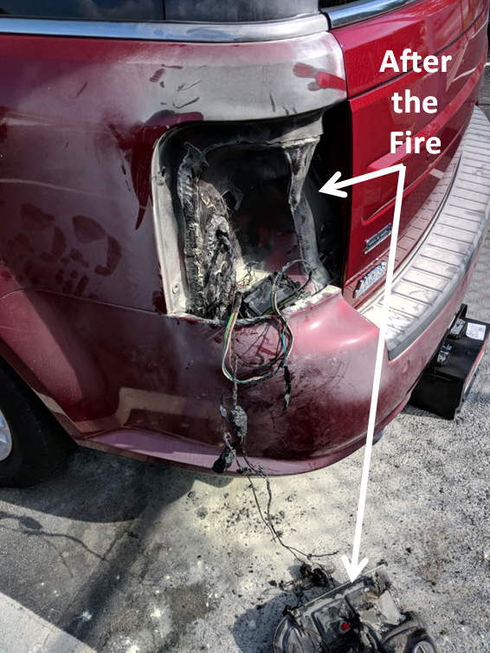
Aftermarket, Junkyard & “Re-manufactured” Parts

Slide 46
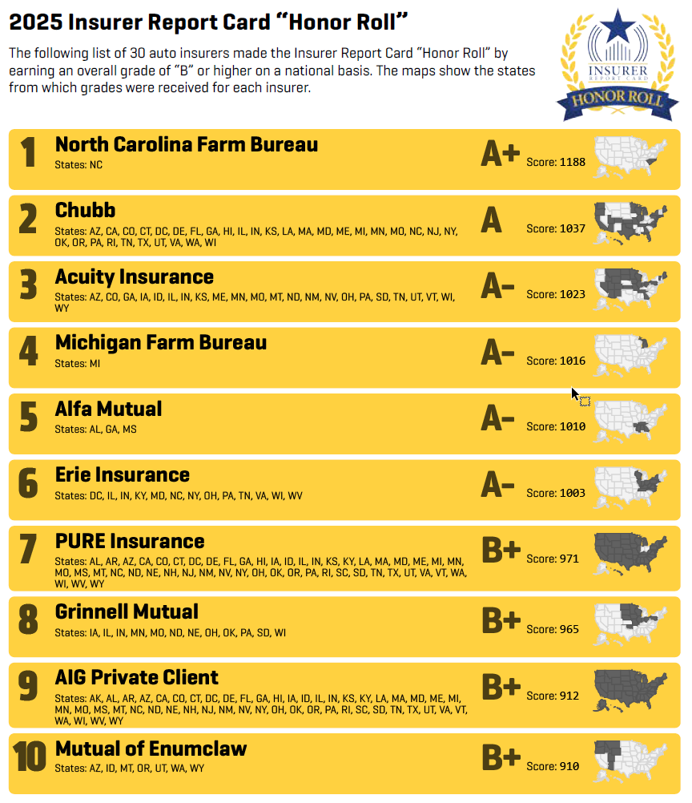
2025 Crash Network Auto Insurer Report Card
CRASH Network is a weekly newsletter for the collision repair industry
Crash Network’s annual survey asks body shops to assign grades from A-F to insurers in response to the following question:
    “How well does this company's claims handling policies, attitude and payment practices ensure quality repairs and customer service for motorists?”

Slide 47
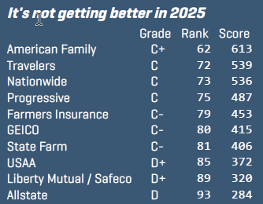
2025 Crash Network Auto Insurer Report Card
None of the 10 largest auto insurers scored higher than the national average (663) nor earned higher than a “C+” grade. More than 60 other companies scored higher.
Lower-graded insurers “tend to have less experienced claims personnel, push shops to install used or lower-quality parts, don't encourage the use of automaker recommended repair procedures, or are slow to respond to shops' requests for reviews and thus increase the time it takes to complete repairs for the customer.”

Slide 48
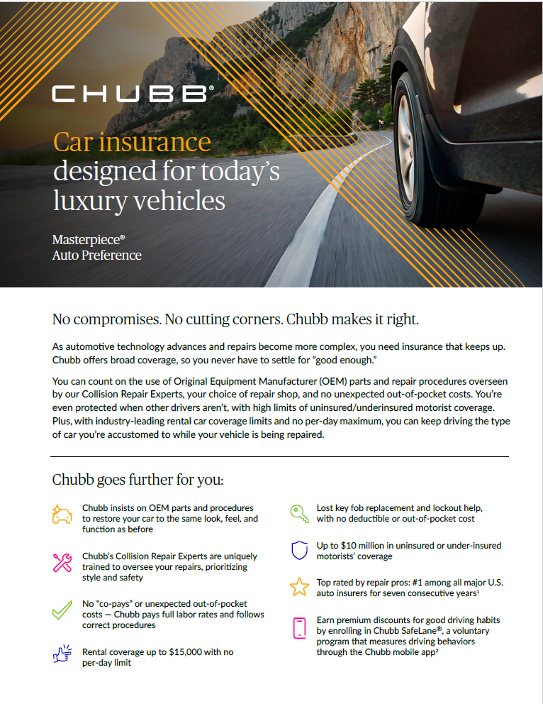
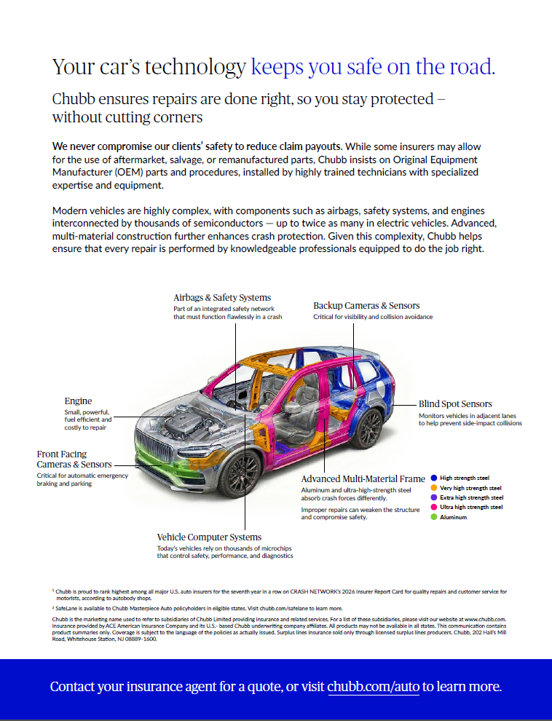
Chubb Auto Marketing Flier

Slide 49
4. Total Thefts
49

Slide 50
4. Total Thefts
While total thefts are down, thieves continue to target high-end makes such as Aston Martin, Bentley, Lamborghini, Mercedes G-class SUVs, Porsche, Range Rover and Rolls Royce.
Clients are also seeing increased thefts by fraudulent transport providers.

Slide 51
5. UM/UIM
51

Slide 52
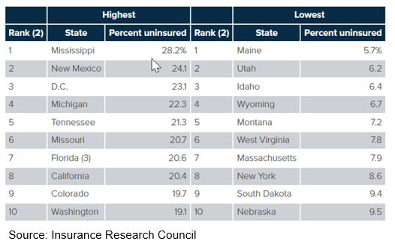
5. UM / UIM
15.4 of motorists in the US are uninsured and approximately 1/3 of vehicles are under-insured with minimum or very low liability limits
    In addition to accidents, UM/UIM coverage also comes into play when clients are hit as pedestrians, while bike riding and as ride share passengers.
    Clients sometime skimp on UM/UIM coverage to reduce their premium, but this is not wise.
    UM/UIM = BI is good rule of thumb.

Slide 53
6. Collector
Vehicle
53

Slide 54
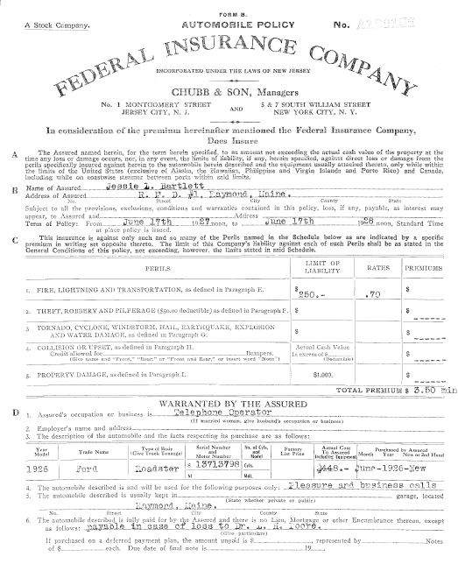
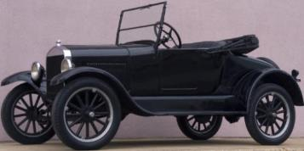
6. Collector Vehicles
Chubb has been selling Auto insurance for a very long time….
    1928 Chubb Auto policy covering a 1926 Ford Roadster.
    $250 of Coverage for “Fire, Lightning & Transportation”.
    Annual premium of $3.50.

Slide 55
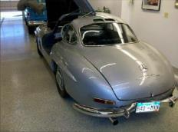
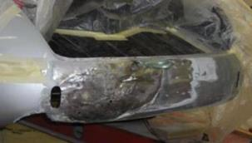
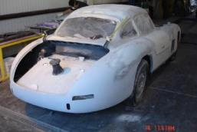
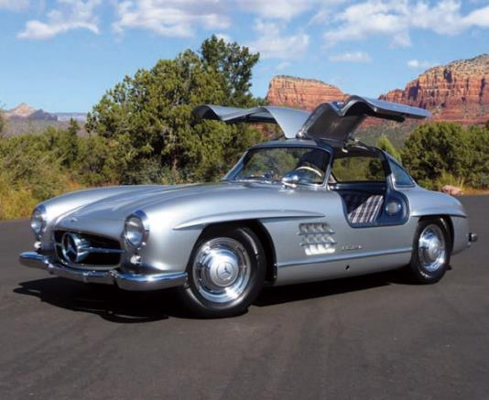
6. Collector Vehicles
We are Experts at Managing Collector Vehicle Repairs
    1956 MB 300SL
    AV: $1.2M
    1 Year Repair
    Full Re-Paint
    $144k paid

Slide 56
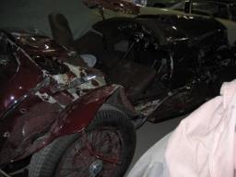
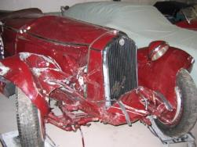
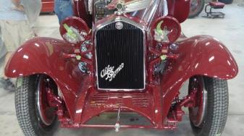
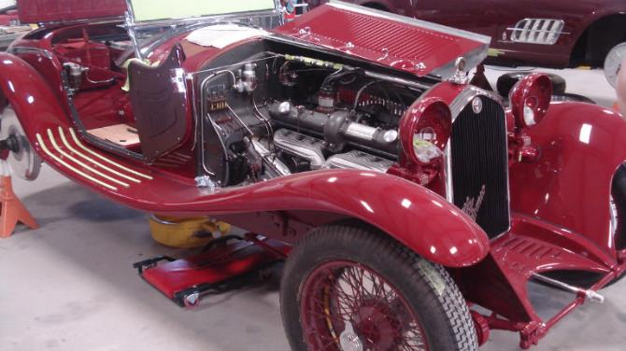
6. Collector Vehicles
We are Experts at Managing Collector Vehicle Repairs
    1932 Alfa Romeo
    AV: $3M
    4 Year Repair
    Custom Fabricated Parts
    $471k paid

Slide 57
6. Collector Vehicles
Chubb is the right choice for clients with collector vehicles….
    Over 70 years of Collector Vehicle expertise
    Can be written on a mono line basis
    Can only be bound by Underwriting
    Credits Available for $250k+ Collections (applied by underwriting)
    Discounted Panorama rating tier if 2 or more CVs on policy

Slide 58
7. Electric
Vehicles
(Evs)
58

Slide 59

7. Electric Vehicles
EV Sales are down due to the elimination of federal tax credits
Source: KBB.com

Slide 60
7. Electric Vehicles
EVs are more expensive than the average new car, but the gap is narrowing as competition increases
Source: KBB.com

Slide 61

7. Electric Vehicles
EVs are concentrated in higher cost East & West Coast states and/or metro areas.
Source: HLDI & Munich Re Perspectives on EVs, 10/08/24

Slide 62

7. Electric Vehicles
EVs are complex to repair & have claim severities similar to those of luxury vehicles
EVs remain considerably more expensive to repair vs non-EVs due to greater use of light weight materials, safety requirements such as battery pack removal before painting, the need for highly trained (and paid) technicians and most parts being bonded/riveted to the vehicle’s structure leading more parts being replaced vs repaired.

Slide 63

7. Electric Vehicles
EV Design Contributes to Higher Collision/PD Severities
It is common for EVs to have expensive light bars that add significantly to Collision and Property Damage severities.
Source: HLDI & Mitchell Perspectives on EVs, 01/23/25

Slide 64

7. Electric Vehicles
EV Design Contributes to Higher Collision/PD Severities
FORD F-150, ICE Version
FORD F-150, EV Version
Source: HLDI & Mitchell Perspectives on EVs, 01/23/25

Slide 65

7. Electric Vehicles
HLDI found that EV non-crash fire frequency is lower than conventional vehicles. This is true for both EVs with corresponding conventional versions and for Teslas when compared to similar non-EV luxury vehicles.

