Slide 1
Why Chubb for your Successful Individuals
Ellen Kroesen VP, PRS Sales & Distribution Training Manager
Development Program || Virtual Session || June 1, 2026
Notes:
3/9/2026 approved by legal || Tina Karkera || 6012485
Notes: HUB presentation “used” the incorrect yellow/orange, correct through out the presentation.
The Wealth Report Presentation done for HUB by Marketing

Slide 2

The Chubb Insured – Successful Families & Individuals
Agenda
Chubb Personal Risk Services Overview
Chubb Target Market
Risk Consulting Overview
Dwelling Replacement Cost
Chubb Masterpiece® Deluxe House Coverage
Chubb Masterpiece® Deluxe Contents Coverage
Chubb Masterpiece® Auto Preference
Chubb Masterpiece® Value Articles
Chubb Masterpiece® Personal & Excess Liability
Chubb Recreations Marine
Chubb Flood
Resources

Slide 3
Chubb
Chubb is a world leader in insurance
Operations in 54 Countries and Territories, where we write business
Exceptional Financial Strength, managing risk conservatively in both underwriting and investing
200+ Years of Experience
The leading personal lines insurer for America’s successful individuals and families and a large personal lines provider globally
Risk Services Expertise
Claims handling
service renowned for its quality, promptness and fairness
Notes:
3/9/2026 approved by legal || Tina Karkera || 6012485
Slide previously approved || Marketing Dept. || Chubb 101 presentation
Core differentiators: the scale, stability, service, capabilities
Chubb is a world leader in insurance. With global capabilities a proud heritage over 200 years strong. We have a long-standing history as a premium insurer that specializes in serving successful families and individuals with more to insure. You get Stability due to our history, experience in the unique niche, in house subject matter experts and additional services we offer our clients. Chubb has a history of finding ways to say yes and ways to do more for our clients. AND of course, the way we constantly reinvest in supporting both our clients and distribution partners.

Slide 4
Chubb
Notes:
3/9/2026 approved by legal || Tina Karkera || 6012485
Slide previously approved || Marketing Dept. || Chubb 101 presentation
Core differentiators: the scale, stability, service, capabilities
Chubb is a world leader in insurance. With global capabilities a proud heritage over 200 years strong. We have a long-standing history as a premium insurer that specializes in serving successful families and individuals with more to insure. You get Stability due to our history, experience in the unique niche, in house subject matter experts and additional services we offer our clients. Chubb has a history of finding ways to say yes and ways to do more for our clients. AND of course, the way we constantly reinvest in supporting both our clients and distribution partners.

Slide 5
Chubb
Notes:
3/9/2026 approved by legal || Tina Karkera || 6012485
Slide previously approved || Marketing Dept. || Chubb 101 presentation
Core differentiators: the scale, stability, service, capabilities
Chubb is a world leader in insurance. With global capabilities a proud heritage over 200 years strong. We have a long-standing history as a premium insurer that specializes in serving successful families and individuals with more to insure. You get Stability due to our history, experience in the unique niche, in house subject matter experts and additional services we offer our clients. Chubb has a history of finding ways to say yes and ways to do more for our clients. AND of course, the way we constantly reinvest in supporting both our clients and distribution partners.

Slide 6








Personal Risk Services Highlights
Products
PRS Highlights
Insurance Market at a Glance
Home
Auto/Collector Car
Valuable Articles
Excess Liability
Renters/Condo
Recreational Marine
Cyber
Flood
95%
of claimants highly satisfied
99.6%
Retention (Premium Basis)
48
Branches in the U.S. &
Canada
~$27B
with Direct &
Mass Market Carriers
38,000+
Annual visits by our 130+
Risk Consultants
400,000+
Submissions
annually
3,000
Agents
$8.1B
Chubb
Financials 2024 2025
~$6B
Collective with other HNW writers
Gross Written Premium
$7.5B | $8.1B
Combined Ratio
83.6% | 93.1%
Confidential & Proprietary Information of Chubb- Not for Distribution
Notes:
3/9/2026 approved by legal || Tina Karkera || 6012485
Chubb’s Personal Risk Services offers a comprehensive range of core insurance products and over 2 years ago we brought flood inhouse. Our portfolio is designed to meet the needs of successful families and individuals who require sophisticated insurance solutions plus we utilize our E & S department, rain and hail department, Travel insurance as well as pet insurance just to name a few. 1
"Our division demonstrates strong performance metrics. 95-five percent of claimants report high satisfaction with our claims service, and we have a 99.6 percent retention rate on a premium basis. We operate forty-eight branches across the U.S. and Canada, process over four hundred thousand submissions annually, and are supported by more than three thousand agents. Additionally, our one hundred and thirty-plus risk consultants conduct over 38 thousand visits each year." 2

Slide 7














Personal Risk Services – Who & What we Insure
$20M
Most Valuable
Baseball Card
22,800
Clients from Digital
Partnerships
$62M
Largest Jewelry
Item
62 of Fortune’s Top
100 US Billionaires
Total Policy Count:
>1,000,000
$250M
Largest Sports Memorabilia
Collection
Total Property
at any One Location
$779M
Family Office
Largest # of Homes - 132
Largest Premium - $7.3M
71,000
Claims handled
in 2024
$257M
Largest
Yacht
$394M
Largest Car Collection
Most Unusual Collectible
$6M T-Rex Skull
$180M
Largest Jewelry
Schedule
$88M
Most
Valuable Car
Confidential & Proprietary Information of Chubb- Not for Distribution
Notes:
3/9/2026 approved by legal || Tina Karkera || 6012485
Scott Tellers slide || Oswald presentation
I created the slide as we are many time ask what have we written the is “different or just a little more unique or stand out in our memory banks.

Slide 8
Personal Risk Services – Claims Service
Delivering Results
for our Clients
Chubb claims adjusters (not third parties)
Satisfaction Score
95%
NPS
86
Claim
Centers
24/7
Confidential & Proprietary Information of Chubb- Not for Distribution
Notes:
Scott Tellers slide || Oswald presentation
3/9/2026 approved by legal || Tina Karkera || 6012485
As stated on my prior slide in 2024 our claims team handle 71,000 claims. Our claims centers operate twenty-four hours a day, seven days a week, and are managed by Chubb claims adjusters, not third parties. This ensures a high-quality, consistent claims experience for our clients. Our Net Promoter Score is 86, reflecting strong client loyalty and satisfaction." 3

Slide 9
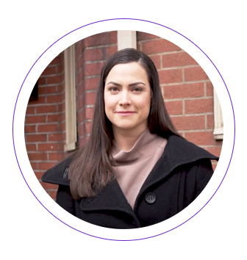

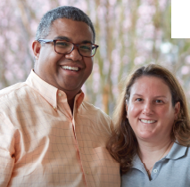
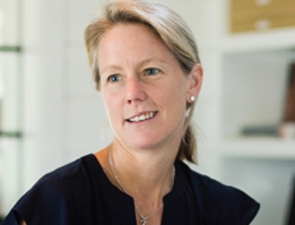


The Chubb Insured – Successful Families & Individuals
The Chubb Insured – Successful Families & Individuals
Insurable wealth
Professional occupation
See insurance as an important financial service
Values our financial position
Appreciate our value-added approach
Interested in loss prevention and resilience
Nearly clean loss experience
Potential for account to grow over time
Require a more sophisticated level of insurance
Wants their carrier to be a full solution provider
Notes:
3/9/2026 approved by legal || Tina Karkera || 6012485
Slide previously approved || Marketing Dept. || Chubb 101 presentation
Generally speaking our ideal client is a successful family or individual with insurable wealth and a professional occupation. They see insurance as an important financial service, value our financial strength, and appreciate our value-added approach. They are interested in loss prevention and resilience, typically have a nearly clean loss experience, and have the potential for their account to grow over time. These clients require a more sophisticated level of insurance and want their carrier to be a full solution provider."

Slide 10

Mindset, purpose — and optimism
RESPONDENT OUTLOOk
Only about half of those with assets between $5
and $25 million currently think of themselves as rich.
Entrepreneurs especially have no desire to retire,
seeing rewards besides money from their business.
79% believe the economy will grow over the next
12 months.
67% feel there are more opportunities to build wealth
now than ever before.
Notes:
3/9/2026 approved by legal || Tina Karkera || 6012485

Slide 11

The 2025
Wealth Report
The resilient mindset:
Turning risk awareness into advantage
Notes:
3/9/2026 approved by legal || Tina Karkera || 6012485

Slide 12
About the
2025 survey
Geographic breakdown
United States
Canada
850
150
To better understand the risks faced by wealthy North Americans, Chubb asked Beresford Research, a global research agency, to conduct a detailed survey about their perceptions, their plans and their concerns.
Demographics
Under 29
(Gen Z)
29-44
(Millennials)
45-60
(Gen X)
61-70
(Boomers II)
71-79
(Boomers I)
80+
(Post War)
5%
14%
29%
23%
19.5%
9.5%
Field period July – September 2025
Investable assets breakdown
Over $1.5million and up to $5 million
Over $25 million and up to $50 million
Over $5 million and up to $10 million
Over $50 million
1,000 surveys were completed by affluent and high-net-worth individuals
20%
20%
20%
20%
Notes:
3/9/2026 approved by legal || Tina Karkera || 6012485

Slide 13
Opportunity Geographies – Investment and Growth
O
AL || Birmingham, Tuscaloosa
AZ || Chandler, Gilbert, Mesa, Paradise Valley, Phoenix, Queen Creek, Scottsdale, Tempe, Tucson
AR ||
CO || Aurora, Colorado Springs, Denver, Englewood, Greely, Windsor
CT || Litchfield, Ridgefield, Wilton, Weston, Upper Fairfield
DE || Middletown, Wilmington
DC || Washington, DC
GA || Atlanta, Canton, Fulton, Marietta, Woodstock
IL || Cook, Dupage, Lake, Will
ID || Carmel, Fishers, Indianapolis
KS || Johnson, Sedgwick
MA || Boston, Berkshire, Lexington, Worcester
MD || Baltimore, Bethesda, Chevy Chase, Gaithersburg, Potomac, Rockville
MI || Kent, Oakland, Wayne
MO || Jackson, St. Louis
NH || Carroll, Hillsborough, Rockingham
NJ || Bergan, Essex, Mercer, Middlesex, Monmouth, Morris, Passaic, Somerset, Union
NV || Clark, Reno,
NY || Brooklyn, Gardon City, Kingston, New Rochelle, Newburgh, Rockland, Saratoga, Upper Westchester, White Plains
OH || Cuyahoga, Franklin, Hamilton, Mason
OR || Eugene, Portland
PA || Blue Bell, Bucks County, Chestnut Hill, Gladwyne, Haverford, Lancaster/Lititz, Malvern, Mount Airy, Philadelphia, Pittsburgh, Rittenhouse Square, Society Hill
TN || Brentwood, College Grove, Franklin, Knoxville, Nashville
TX || Argyle, Austin, Colleyville, Dallas, Fort Worth, Frisco, San Antonio, Southlake, Woodlands
VA || Alexandria, Arlington, Ashburn, Fairfax, Falls Church, Leesburg, McLean, Middleburg, Richmond, Vienna, Williamsburg
WA || Seattle, Spokane
WI || Milwaukee, Waukesha
13
Notes:
Update new slide – Tina you approved it for the Howden presentation we just added all areas – Presenter would use slide 8 or 9 not both.

Slide 14
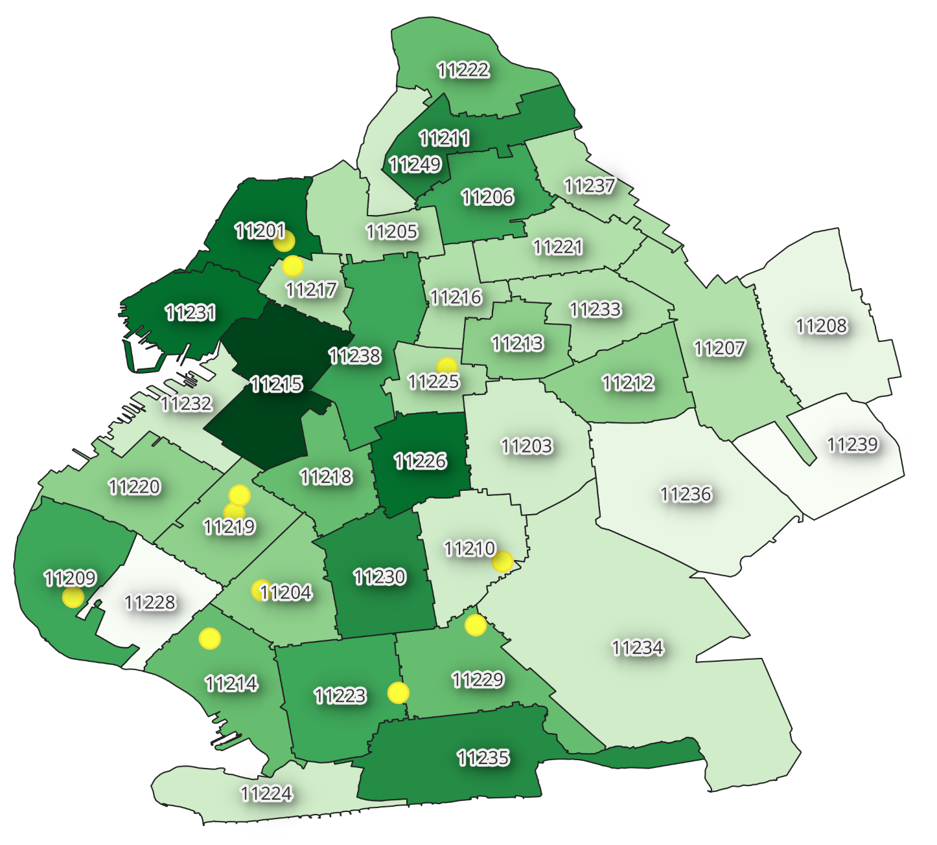
Opportunity for New Joint Investment in Brooklyn, NY: Homes ($3M+)
Zip code 11201
Williamsburg
3,016 opportunities
Zip code 11231
Williamsburg
2,104 opportunities
54,000 $3M+ House/City Home Opportunities
Low agency representation
Zip code 11215
Park Slope
3,598 opportunities
Size of Risk | Opportunity Count
$3m to $5m | 24,125
$5m+ | 30,342
Zip code 11226
Flatbush
2,216 opportunities
Zip code 11230
Midwood
1,875 opportunities
%
14
Notes:
3/9/2026 approved by legal || Tina Karkera || 6012485

Slide 15

Questions?
HUB-Chubb
15
Notes:
Add this disclosure per legal’s request -3/9/2026 approved by legal || Tina Karkera || 6012485

